Slide 1
CS 4504 Parallel and Distributed Computation Decentralized Structure
Kun Suo
Computer Science, Kennesaw State University
https://kevinsuo.github.io/

Slide 2
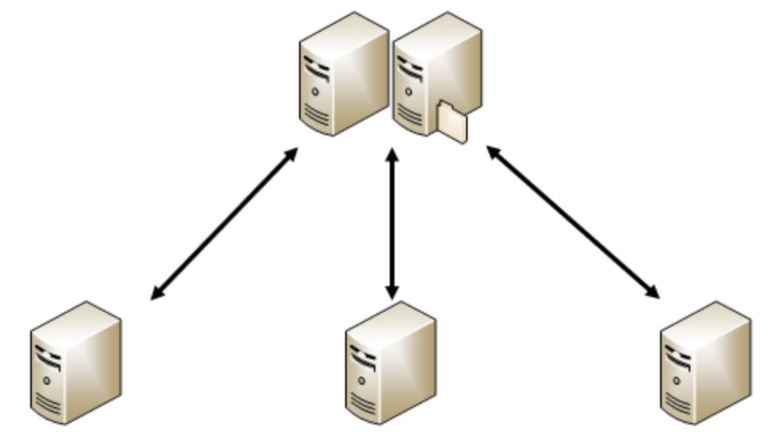
Revisit Centralized Structure
The central server is composed of one or more servers.
All data in the system are stored in the central server, and all business in the system is processed by the central server first. The central server performs resource and task scheduling.
Multiple node servers are connected to the central server and report their information to the central server. The central server sends tasks to the node server based on the information; the node server executes the tasks and sends the results & feedback to the central server.
Central server
Node servers

Slide 3
Revisit Centralized Structure
Advantages:
Simple structure
Centralized manage and scheduling, the node servers do not need to communicate with each other and only need to communicate with the central node
Central server
Node servers

Slide 4
Revisit Centralized Structure
Disadvantages:
This structure has high requirements on the performance of the central server
Single point of bottleneck
Single point of failure
Central server
Node servers

Slide 5
Decentralized Structure
Decentralized Structure is also named as distributed structure
Service execution and data storage are distributed to different server clusters
Communication and coordination between server clusters are through message passing

Slide 6
Decentralized Structure
Advantages:
No central server or node server, all servers are equal (peer-to-peer) and the structure is flat
No single point bottleneck and single point of failure
Improved system concurrency, more suitable for large-scale cluster management

Slide 7
Example of Decentralized Structure: Akka cluster
Actor model: An object that encapsulates state and behavior. It receives messages and performs computation based on the message
Actors are isolated from each other and do not share memory
Actors can communicate through mail exchange
In a distributed system, a server or a node can be regarded as an Actor. Mail is used for communication between Actors.

Slide 8
Example of Decentralized Structure: Akka cluster
What is a Akka cluster?
Akka cluster is based on Actor model
It is an asynchronous, non-blocking, high-performance event-driven programming model
It provides a non-centralized architecture cluster management module for building scalable and elastic distributed applications

Slide 9
Example of Decentralized Structure: Akka cluster
Who to manage the nodes in Akka cluster?
Nodes are divided into Leader nodes and non-Leader nodes.
Compared with non-Leader nodes, the Leader node only adds the function of adding and removing nodes responsible for the node.
All nodes are equal in the decentralized structure
Leader
Non-Leader
Non-Leader
Non-Leader

Slide 10
Example of Decentralized Structure: Akka cluster
1->2
How to transmit data in Akka cluster?
Suppose node 1 tries to modify X from 1 to 2, how to guarantee the data consistency?
Review distributed consensus in previous courses
X=1
X=1
X=1
X=1

Slide 11
Example of Decentralized Structure: Akka cluster
1->2
How to transmit data in Akka cluster?
Each node periodically selects k nodes from the list of nodes maintained by itself, and sends its data information to these k nodes to reach a consensus
X=2
K=3, period 1
X=2
X=2
X=1

Slide 12
Example of Decentralized Structure: Akka cluster
1->2
How to transmit data in Akka cluster?
Each node periodically selects k nodes from the list of nodes maintained by itself, and sends its data information to these k nodes to reach a consensus
X=2
K=3, period 1
X=2
X=2
K=3, period 2
X=2

Slide 13
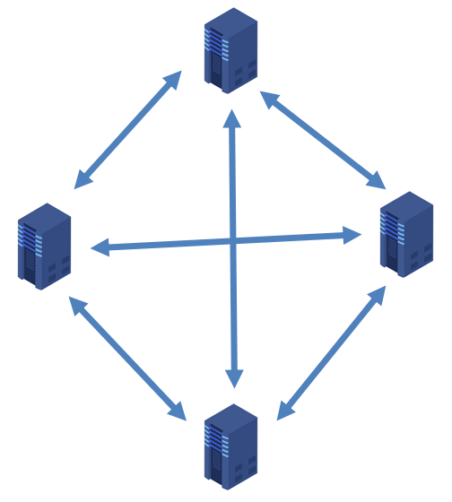
Example of Decentralized Structure: Akka cluster
How to create Akka cluster?
When creating Akka cluster, all nodes are divided into 3 categories:
Seed node: we can have multiple seeds and the seed nodes are defined by static configuration file or in runtime
First seed node: the first seed among all seed nodes. E.g., Node A
Normal node: they can send “Join” message to the seed nodes and apply to join the cluster. E.g., Node B & C

Slide 14
Example of Decentralized Structure: Akka cluster
How to create Akka cluster?
Create Akka cluster:
If this node is the first seed node, add itself to the cluster list, build a cluster centered on itself;
if this node is a seed node, sends requests to the first seed node to join the cluster. If the first seed node approves, join the cluster;
if this node is a normal node, sends requests to any seed node (including the first seed node) to join the cluster. If seed nodes approve, join the cluster.

Slide 15
Example of Decentralized Structure: Akka cluster
Akka cluster is a completely decentralized cluster management system. After the cluster is created, each node can execute the Actor application, so it supports concurrent operations
Akka cluster works like nervous tissues

Slide 16
Example of Decentralized Structure: Redis cluster
Redis is an open source, high-performance distributed key-value database and data can be stored on different Redis nodes
Support data persistence, which can save the data from memory to disk, and can be reloaded and used again when system reboots;
Support multiple data structures, including key-value, list, set, and hash
Support data backup

Slide 17
Example of Decentralized Structure: Redis cluster
How to achieve data reliability on a distributed Redis cluster?
Each node in the cluster has one active and one standby, which means that two Redis services are running on each server

Slide 18
Example of Decentralized Structure: Redis cluster
How to store data on a distributed Redis cluster?
The Redis cluster uses cluster sharding to implement data sharding, which distributes Redis write operations to multiple nodes and improves the write concurrency capability.
Input
Key
Value
Value Range:
[0, 1000]
Value Range:
[1000, 2000]
Value Range: [2000, 3000]

Slide 19
Example of Decentralized Structure: Redis cluster
Redis distributed cluster
Non-centralized cluster management system, without a central node, will not cause a performance bottleneck due to a single node
Each node supports data storage and uses data sharding storage to improve the concurrent writing capacity.
Each node adopts the active and standby design, which improves the reliability
Redis is widely used by Twitter, Uber, GitHub, Instagram, etc.

Slide 20
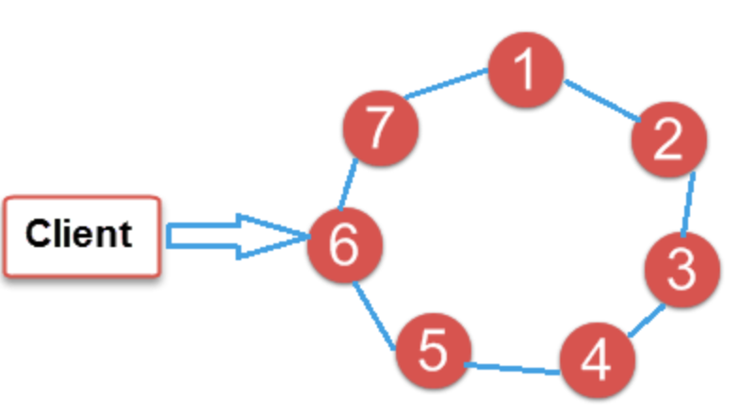
Example of Decentralized Structure: Cassandra cluster
The Cassandra architecture is a complete P2P structure based on consistent hashing
No master node, all nodes have the same role
The synchronization between Cassandra nodes is through P2P
Each node in the cluster can store data and receive requests from clients

Slide 21
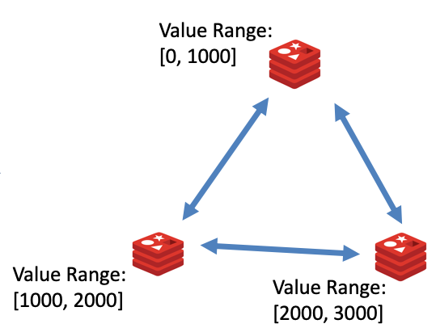
Example of Decentralized Structure: Cassandra cluster
Difference between Redis cluster and Cassandra cluster:
Each node in Redis cluster contains a range of hash value
Each node in Cassandra cluster contains one single hash value

Slide 22
Example of Decentralized Structure: Cassandra cluster
Cassandra distributed cluster
Non-centralized cluster management system, without a central node, will not cause a performance bottleneck due to a single node
Each node stores a single hash value for distributed storage
The nodes use P2P for communication
Redis is widely used by Apple, Comcast, eBay, Netflix etc.

Slide 23
Comparison
 | Akka cluster | Redis cluster | Cassandra cluster
Support model | Actor model | Key-value | Key-value
System architecture | P2P structure | Network topology | P2P structure
Communication | Gossip protocol on network | Gossip protocol on network | Gossip protocol in P2P
Data storage | Store data on some configured nodes | Data sharding on different nodes | Store different hash value on various nodes
Whether the cluster needs a leader node? | Yes | Yes | No

Slide 24
Scenarios for Decentralized Structure
Although the centralized structure is easy to build, however, it introduces single-point bottleneck and single-point failure. Non-centralized structures are the preferred options for large-scale distributed systems
Edge computing is to provide application developers and service providers with cloud services at the edge of the network; the goal is to provide computing, storage, and network bandwidth near data inputs or users. Also, Edge computing involves massive devices and has high requirements for reliability and speed. It is better to use decentralized structure for edge computing.

